Slide 1
Big Mountain Resort
Springboard Guided Capstone - Presentation

Slide 2
Context:
Big Mountain Resort, a ski resort in Montana with access to 105 trails, sees about 350,000 skiers and snowboarders a year with an average of 5-day visits.
They have recently installed an additional chair lift to increase visitor distribution. This has increased operating costs by $1.5M per season.
Their current pricing strategy is to charge a premium above the market average of similar resorts. There is concern that not all of its facilities are being capitalizing on.
We will be providing guidance for implementing a more data-driven business strategy to offset the cost of the newly install lift.

Slide 3
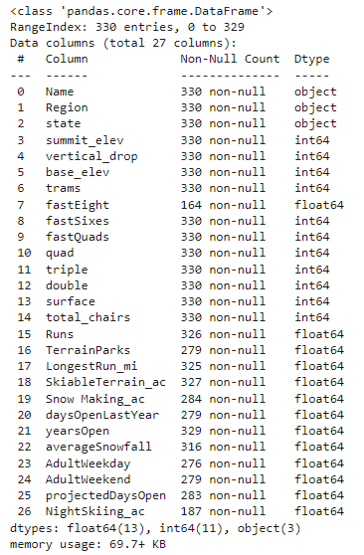
Objectives:
Analyze state population and area information to get a better picture of the market.
Analyze the resort’s most important features and their impact on ticket price, operating costs, and overall revenue
Use data obtained from the BMR’s database manager to build a predictive model for ticket price.

Slide 4
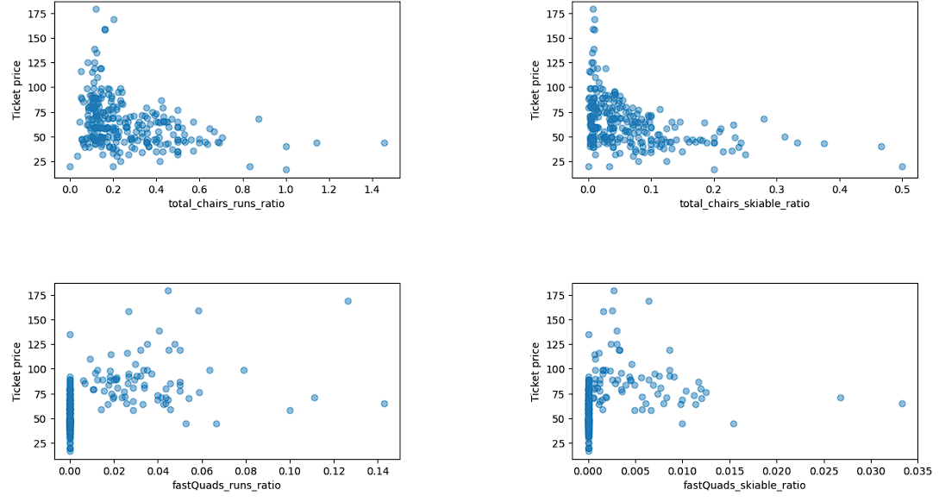
Key Findings:
By generating a heat map to visualize the correlations between different numerical features and price data, we were able to identify several potential factors that led to higher ticket: vertical_drop, fastQuads, total_chairs, Runs, Snow Making_ac, and NightSkiing_ac
Further analysis of the data through scatter plots confirmed these correlations as visualized in part here:

Slide 5
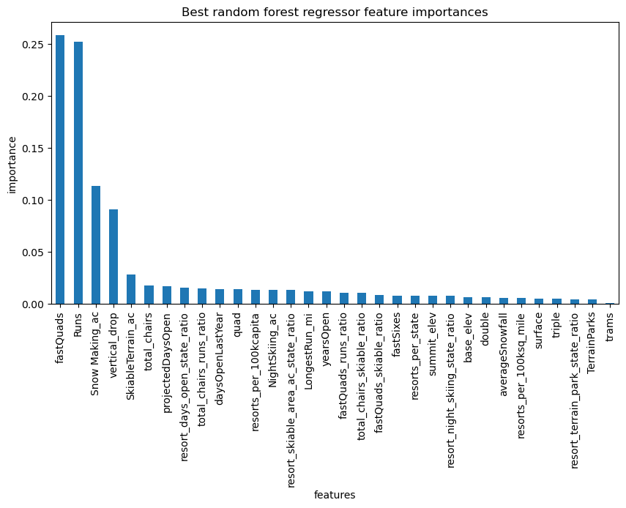
Model Analysis
We developed a model to help impute missing values and calculate price recommendations based on a number of facilities or properties boasted by resorts in the market share.
To note: As some ticket prices were filled based on mean value, our results may be skewed. Additionally, as we are basing our accuracy on the prices of other resorts, we are assuming that their prices are set according to what the market supports.
As we discovered with our correlation scatter plots, our model demonstrates the dominant 4 features affecting ticket price were: fastQuads, Runs, Snow Making_ac, and vertical_drop.

Slide 6
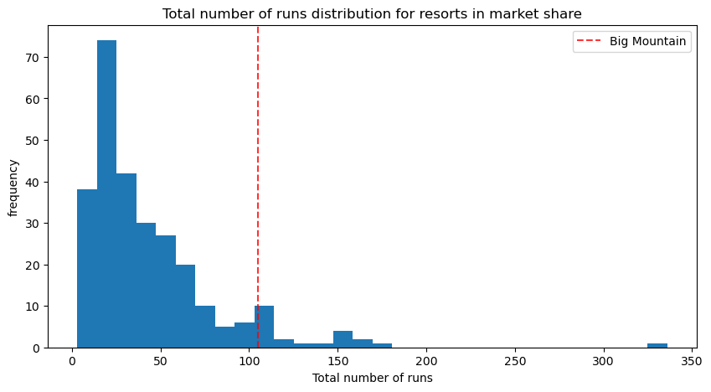
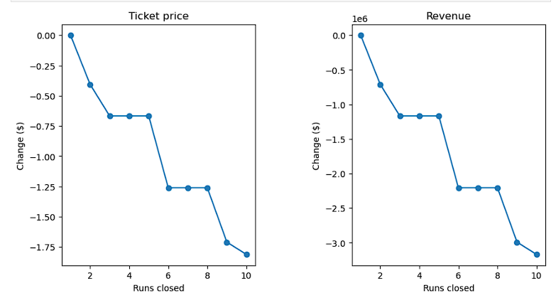
Model Analysis
BMR has been reviewing potential scenarios for either cutting costs or increasing revenue. We can use our model to evaluate these scenarios:
1. Closing runs: BMR has a competitive advantage regarding number of runs. The model says closing one run will not impact ticket price but can reduce operating costs. However closing two or three runs will directly impact revenue without reducing operating costs enough to offset the loss. If closing more than one run is considered, BMR may as well close 4-5 to lower operating costs. Closing more than 6 will lead to detrimental losses.
2-3. Adding a run and increasing Vertical Drop by 150’: According to our model, there is support for increasing ticket price by $1.99 which could be expected to amount to $3,474,638 in revenue over the season. Adding 2 acres of snow-making will not affect the outcome.
4. Increasing longest run: Our model indicates this will not affect our ticket price.

Slide 7
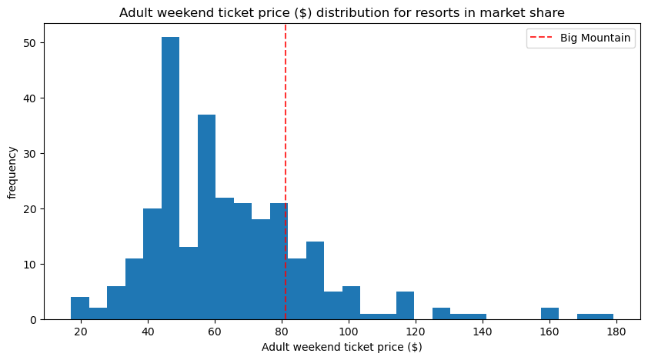
Recommendations:
According to the model we built, BMR could charge $95.87 (+/- $10.39) and still be supported in the marketplace:
We visualized where it sits overall among all the other resorts in the market share by plotting the price distribution of the resorts in the data.
Currently, the price of an `AdultWeekend` ticket at Big Mountain is $81.0.
An increase in ticket price would help pay for the operating costs of the new chair lift.

